Slide 1
Too much of a good thing?
Pink Salmon abundance in the Indian River
Brian McGreal

Slide 2
Overabundance of Endemic Species

Slide 3
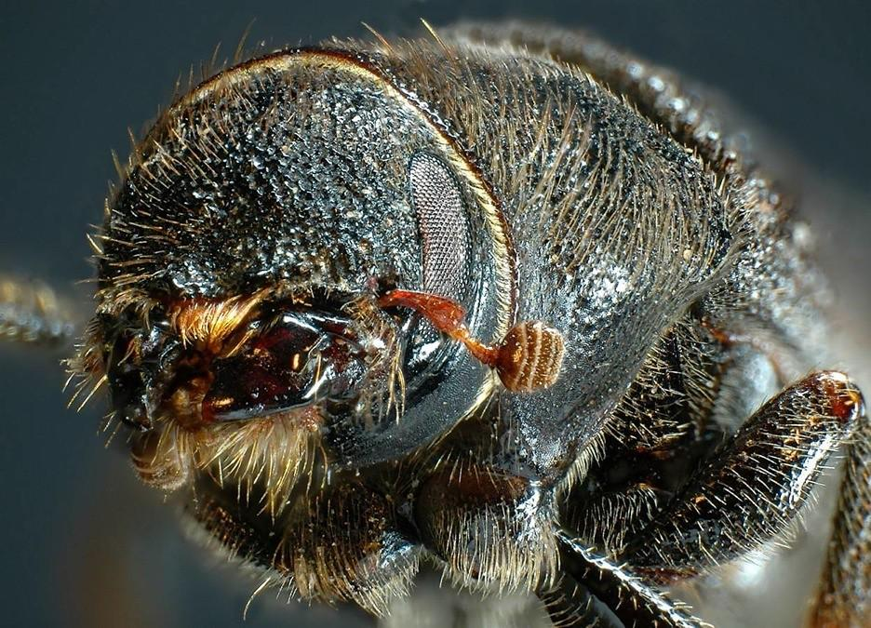
Overabundance of Endemic Species
Mountain Pine Beetle
Endemic to western US and Canada
Life cycle destroys coniferous trees
Shifting climate leads to outbreaks
Credit: Simon Fraser University

Slide 4
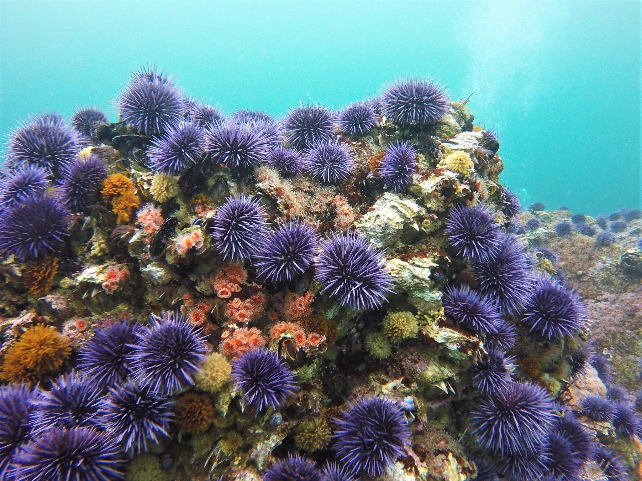
Overabundance of Endemic Species
Sea Urchins
Pacific coast of US and Canada
Feed on kelp
Decimated otter populations have reduced natural predation
Credit: Oregon State University

Slide 5
National Parks and conservation
“[The National Park Service] shall promote and regulate the use of Federal areas known as national parks… which purpose is to conserve the scenery and the natural and historic objects and the wildlife therein and to provide for the enjoyment of the same in such manner and by such means as will leave them unimpaired for the enjoyment of future generations”
–NPS Organic Act of 1916

Slide 6
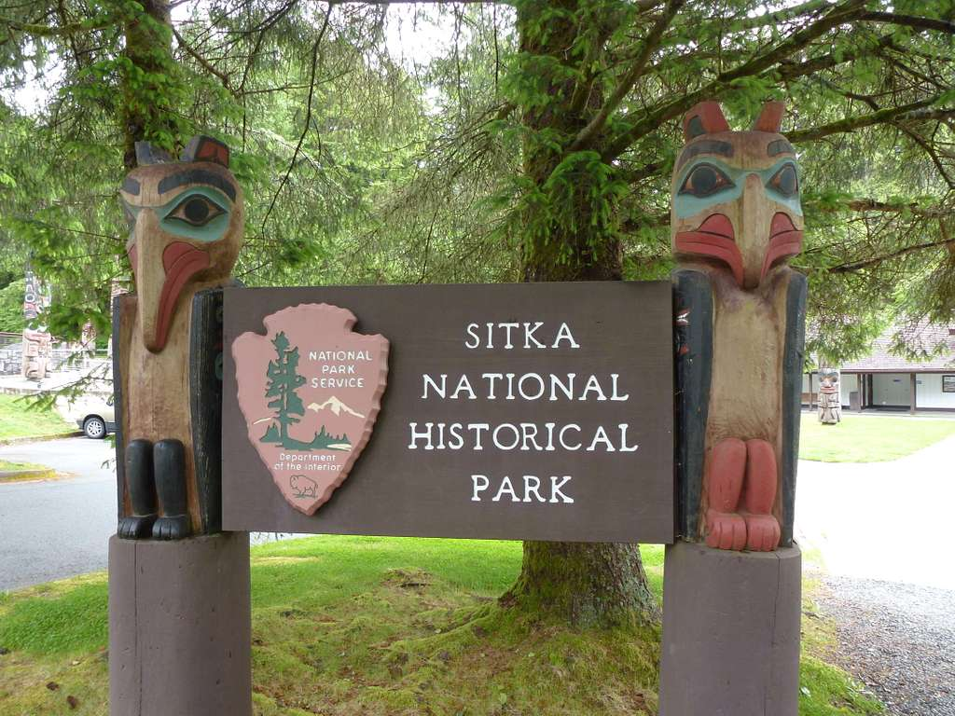
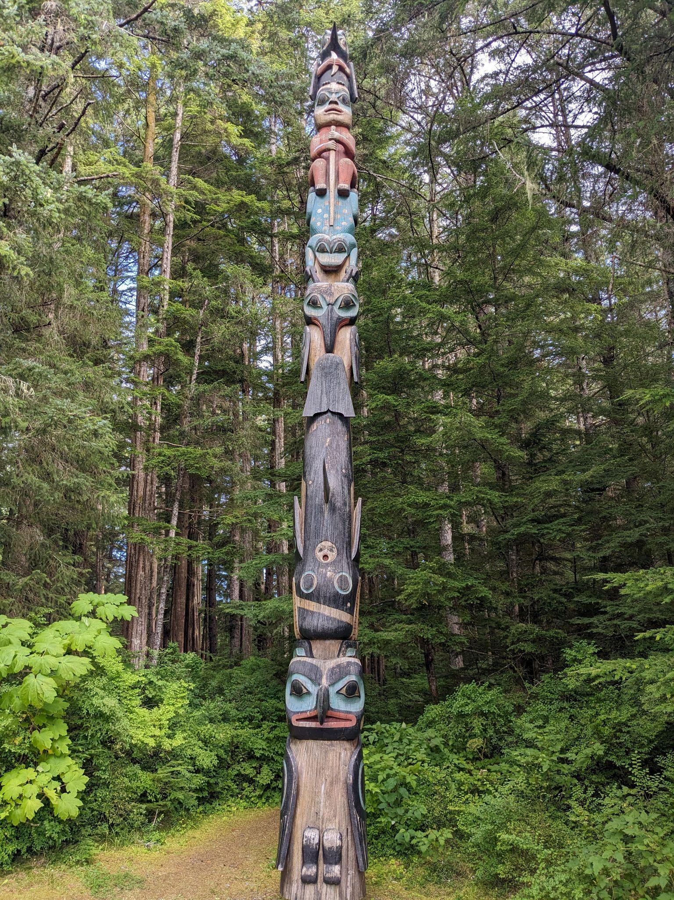
Sitka National Historical Park
Credit: John Bromley

Slide 7
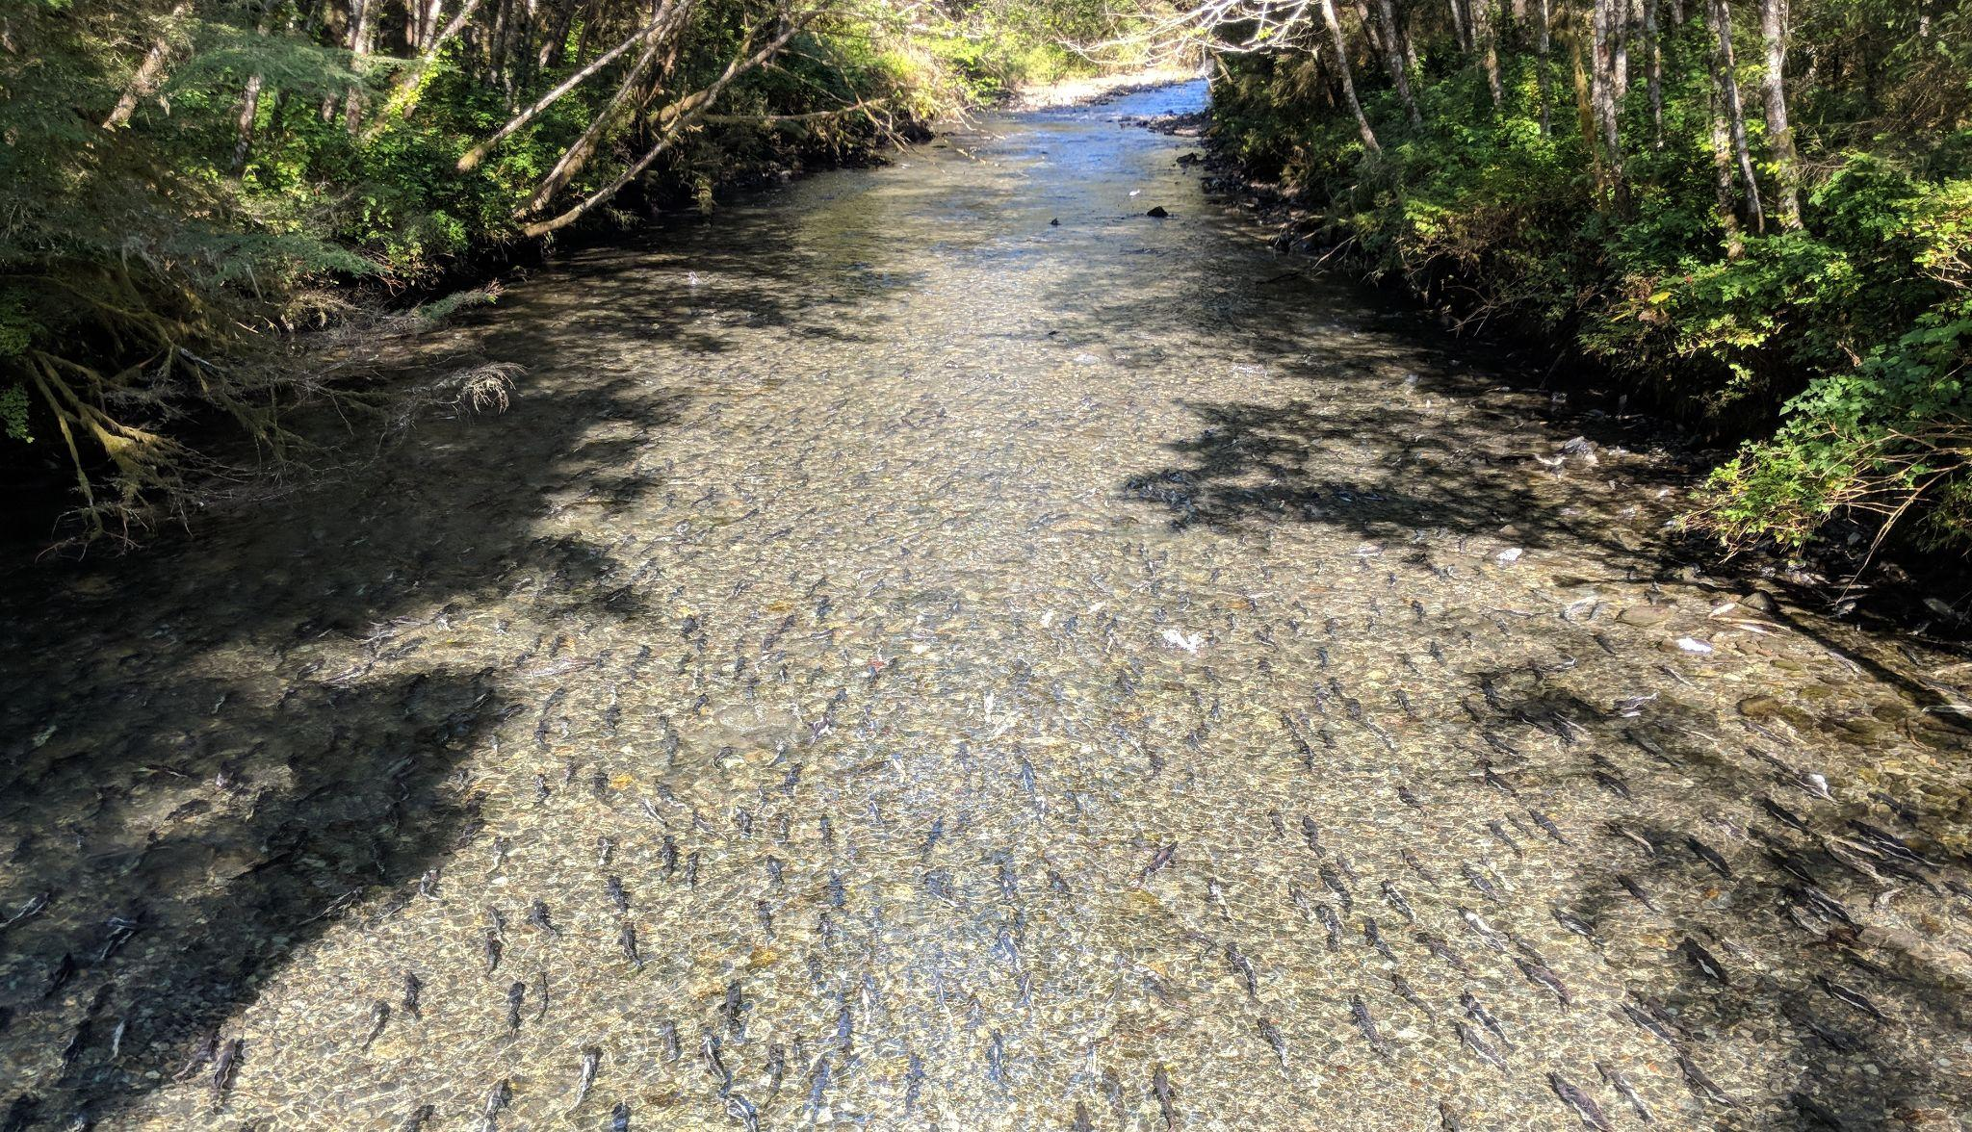
Sitka National Historical Park
Indian River
Notes:
a.k.a. Kaasda Héen
Predominant natural feature
Supports large pink salmon runs
Home to rainbow trout, Dolly Varden, cutthroat trout, stickleback, sculpin

Slide 8
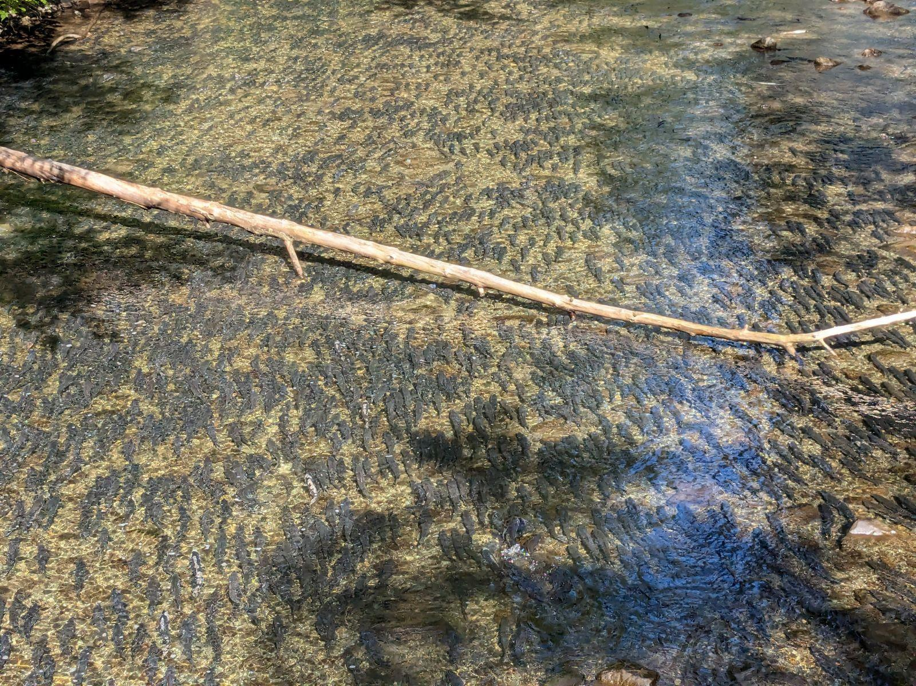
Sitka National Historical Park
Indian River
Notes:
a.k.a. Kaasda Héen
Predominant natural feature
Supports large pink salmon runs
Home to rainbow trout, Dolly Varden, cut

Slide 9
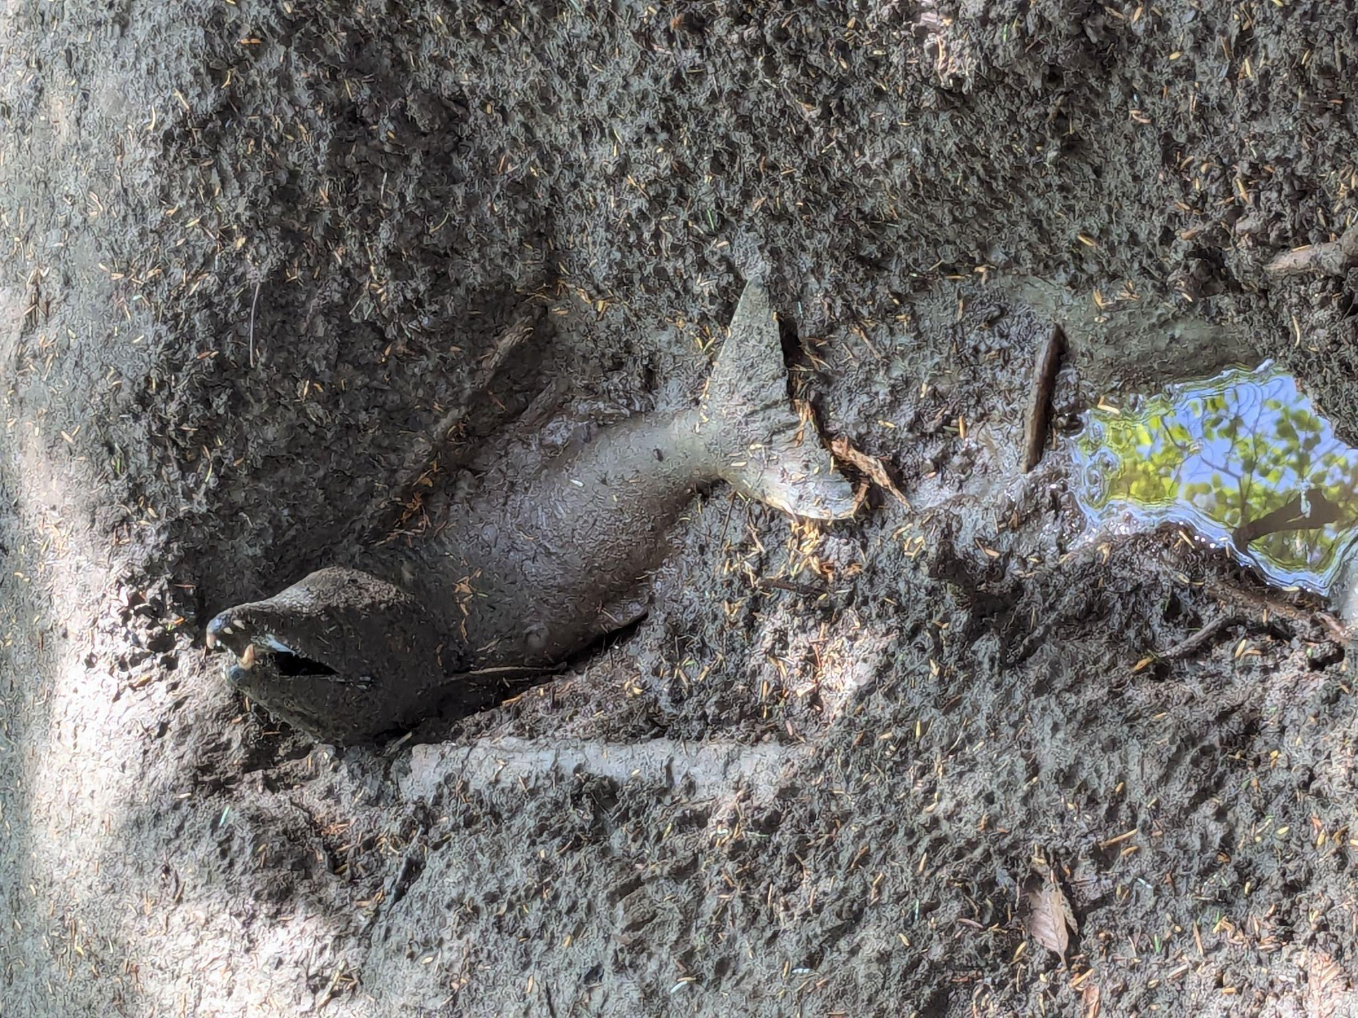
Sitka National Historical Park
Overabundance
Spawning pink salmon deplete DO during low flow periods
Detrimental to other resident species

Slide 10
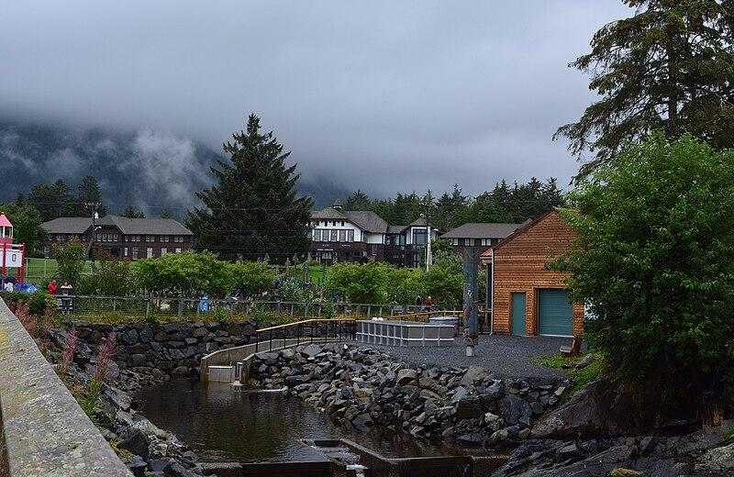
Sitka National Historical Park
Sheldon Jackson Hatchery
Releases 3 million pink salmon per year
Draws water from Indian River
Broodstock from Indian River and Starrigavin Creek
Credit: Joe Mabel

Slide 11
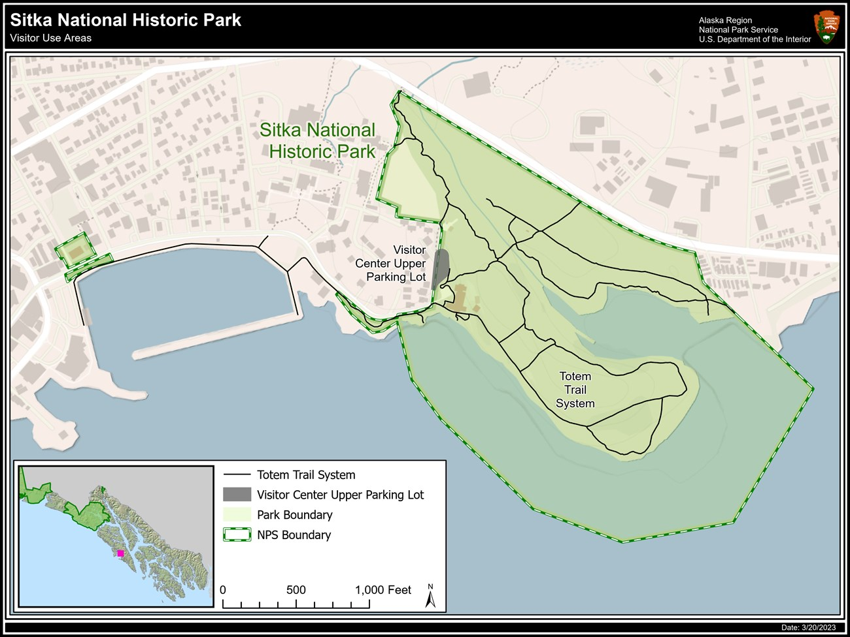
Sitka National Historical Park
Sheldon Jackson Hatchery
Credit: National Park Service

Slide 12

Sitka National Historical Park
Sheldon Jackson Hatchery
Credit: National Park Service

Slide 13
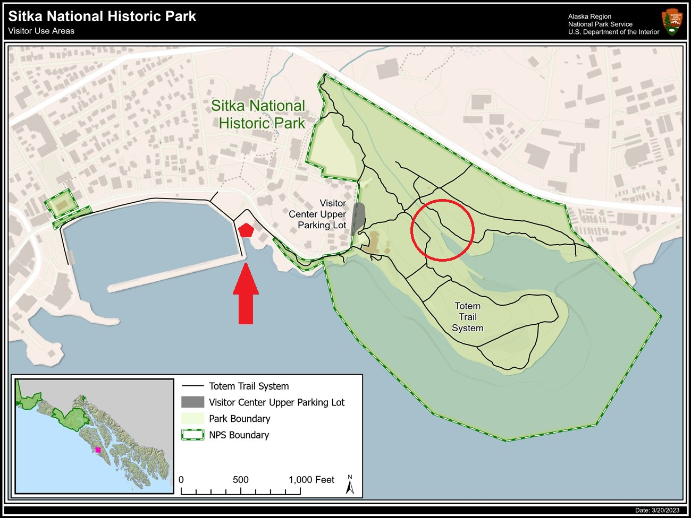
Sitka National Historical Park
Sheldon Jackson Hatchery
Credit: National Park Service
Notes:
Approx. 1,600 feet from hatchery to river mouth

Slide 14
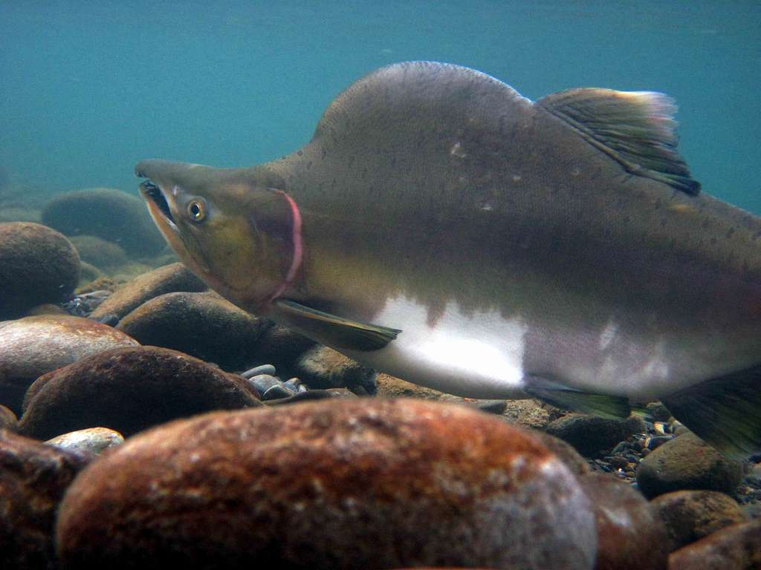
Pink Salmon in Southeast Alaska
Most numerous salmon species in the region
Most caught by landed weight
High rates of straying relative to other salmon species
Credit: National Parks Gallery

Slide 15
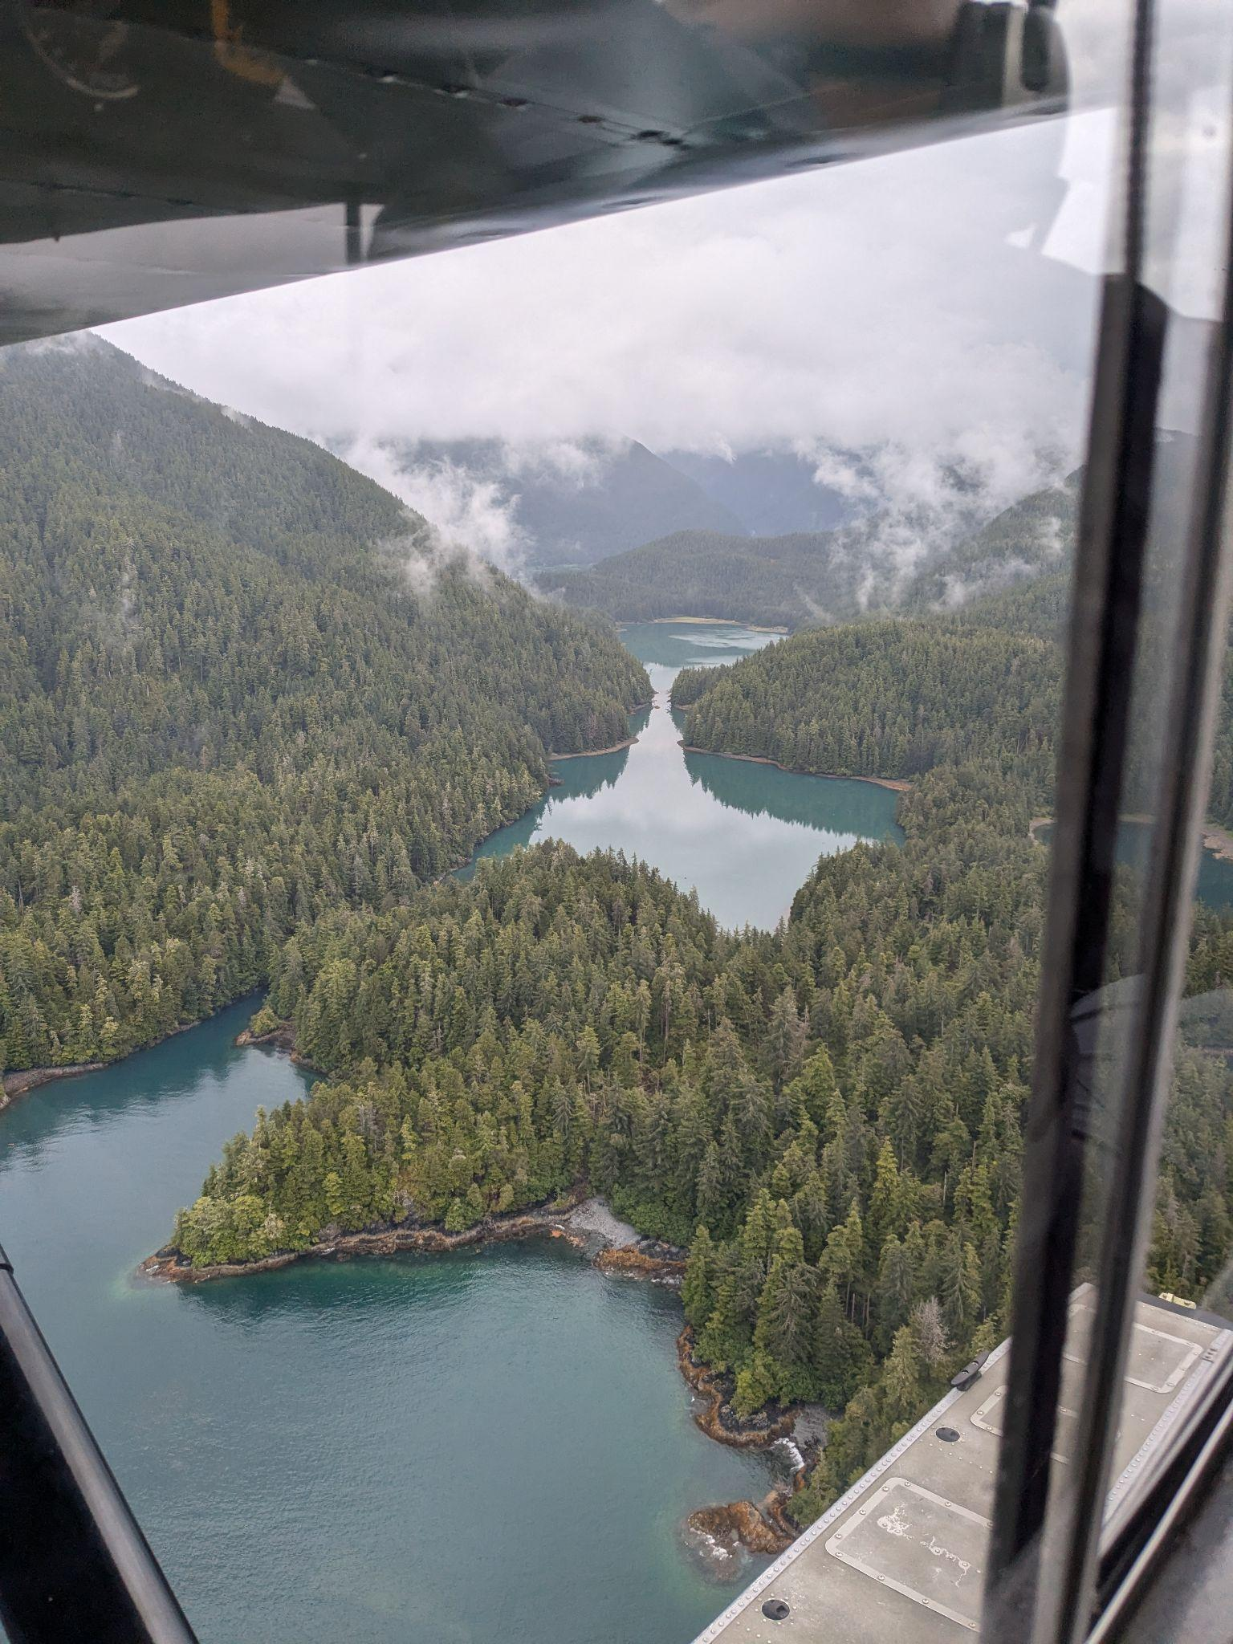
Where does the data come from?
Alaska Dept of Fish Game
Fixed wing aircraft survey
714 pink salmon index streams in SE Alaska
Assessing escapement in order to regulate fishery
Data validated by random foot counts
Credit: Aaron DuPuis

Slide 16
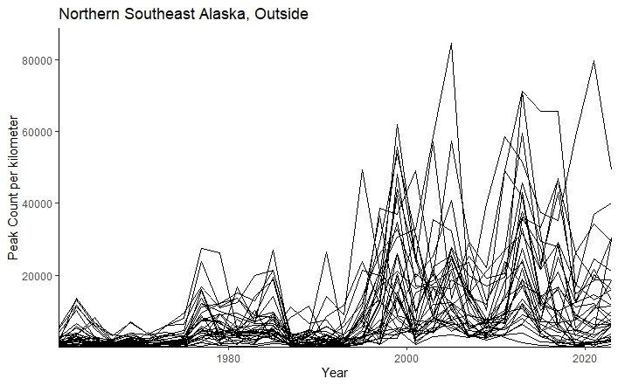
Pink Salmon in Southeast Alaska

Slide 17
Where does the Indian River fit in this picture?

Slide 18
Where does the Indian River fit in this picture?
H0: Sheldon Jackson Hatchery pink salmon releases do not contribute to the abundance of pink salmon in the Indian River

Slide 19
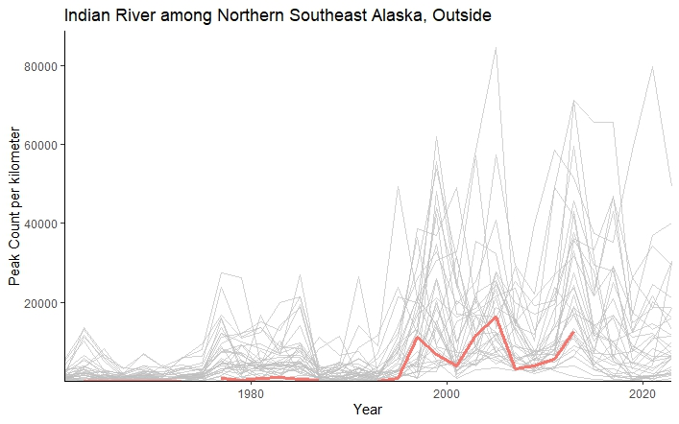
Where does the Indian River fit in this picture?

Slide 20
Where does the Indian River fit in this picture?
State-space model:
xt = Bxt−1 + u + Cct + Gwt, where wt ∼MVN(0,Q)
yt = Zxt + a + Ddt + Hvt, where vt ∼MVN(0,R)
😵
The gist: Estimates underlying state (xt) based on what is observed (yt)

Slide 21
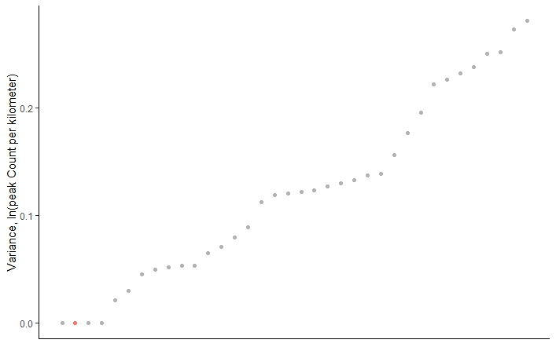
Where does the Indian River fit in this picture?
Year to year variance

Slide 22
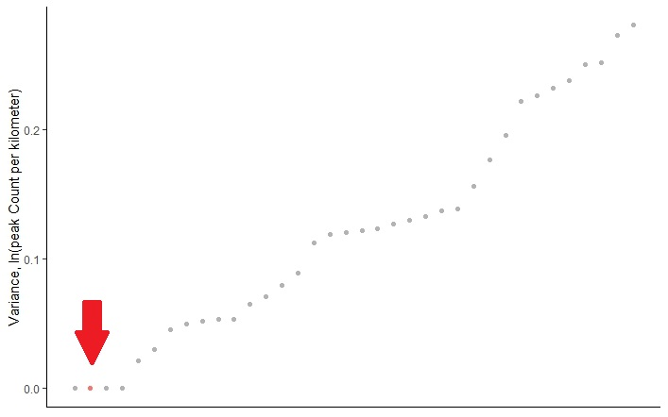
Where does the Indian River fit in this picture?
Year to year variance
Notes:
Low variance but still comparable to natural index streams

Slide 23
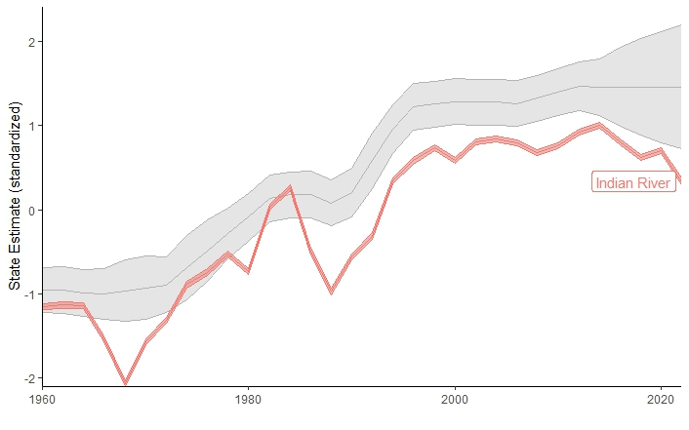
Where does the Indian River fit in this picture?
States

Slide 24
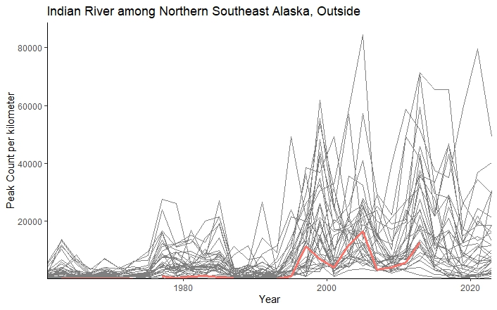
Where does the Indian River fit in this picture?
So far, nothing about this system seems out of line with the broader region…

Slide 25
Implications
Pink salmon abundance may be due to regional trends
Complicated management challenge
What is a “natural” condition?
Credit: National Park Service

Slide 26
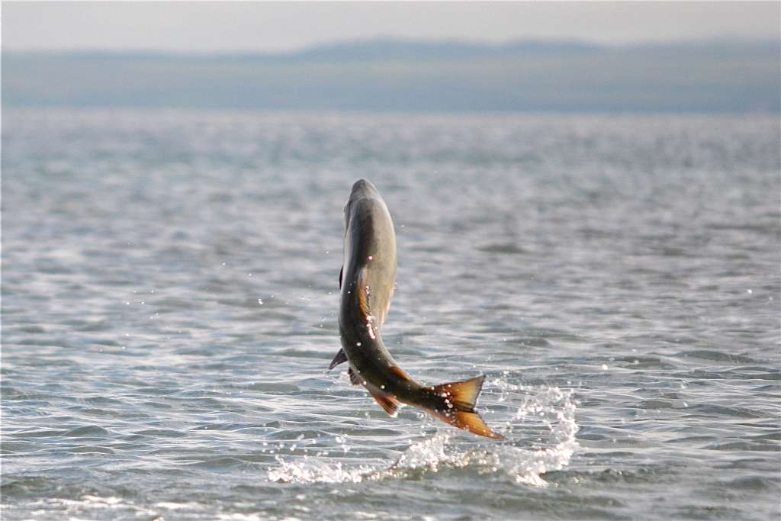
Next steps
Scaling salmon count data by habitat area
Modeling Indian River system directly
Including known stray rates to and from hatchery
Incorporating stream level variables
Credit: US Fish and Wildlife Service

Slide 27




Thank you
Brian McGreal bmcgreal@uw.edu

